Slide 1
GOKULAKRISHNAN M 112721214004
Final Project
3/21/2024 Annual Review

Slide 2

Play Store App Reviews
3/21/2024 Annual Review

Slide 3


AGENDA
Introduction
Codes (Input)
Output
Conclusion
3/21/2024 Annual Review

Slide 4

PROBLEM STATEMENT
The Play Store apps data has enormous potential to drive app-making businesses to success. Actionable insights can be drawn for developers to work on and capture the Android market. Each app (row) has values for category, rating, size, and more. Another dataset contains customer reviews of the android apps. Explore and analyse the data to discover key factors responsible for app engagement and success.
3/21/2024 Annual Review

Slide 5

PROJECT OVERVIEW
This Project is about the analysis of play store consumers
Where this particular data will be used to check and analyze the reaction of the cosumers for the particular product
This database will help to identify how much a particular app is liked by the consumer
3/21/2024 Annual Review

Slide 6

WHO ARE THE END USERS?
The users are 12+ humans who can get a proper idea about the app and make use of it to own and enhance knowledge in their respective interested field
So the overall product can be used to find intrest.
3/21/2024 Annual Review

Slide 7

YOUR SOLUTION AND ITS VALUE PROPOSITION
Comprehensive Analytics:
Our Play Store analytics app provides users with a comprehensive overview of their app performance metrics, including downloads, ratings, reviews, and revenue.
Users can track these metrics over time, allowing them to identify trends and patterns in their app's performance.
Customizable Alerts:
Users can set up custom alerts based on specific events, such as a sudden increase or decrease in downloads, changes in ratings, or revenue milestones.
These alerts help users stay informed about significant developments related to their apps and take timely actions when necessary.
3/21/2024 Annual Review

Slide 8

THE WOW IN YOUR SOLUTION
Here it has been separated by sores for each users to gain the average of liked consumers in the population
3/21/2024 Annual Review
8

Slide 9
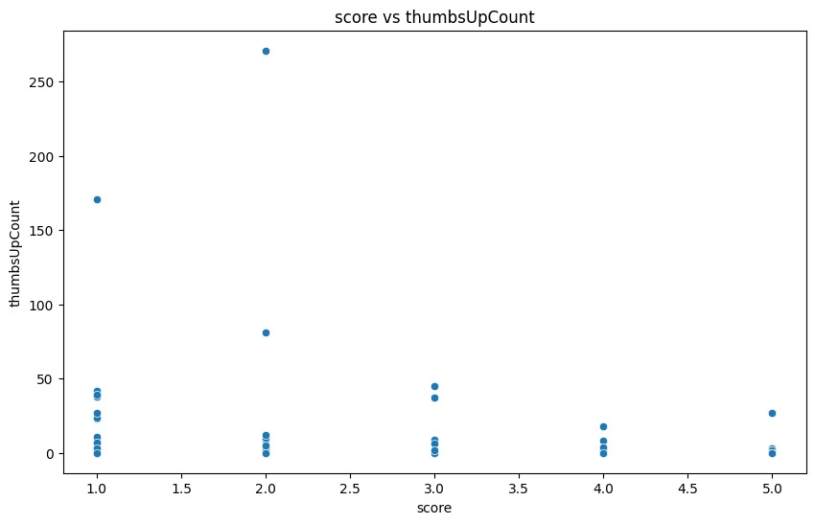
RESULTS
Demo Link
3/21/2024 Annual Review
9

